Slide 1
Percentage
PRATYUS PRATYE

Slide 2
AGENDA
Concepts
Explanation
Class Exercise
Practice, Practice & Practice
Class Test/Recap
Open Discussion
Different types of questions asked

Slide 3
What is Percentage?
Percentage is derived from the word “Cent”
Cent = 100
Percent= Per 100 /Out of every 100
First time it was used by Romans to collect Tax.
Percentage is used to make calculation Easier/ Simpler and Uniform.

Slide 4
Conversions
Conversion of Fraction to Percentage Conversion of Decimal to Percentage

Slide 5
Conversion of Percentage to Fraction and Decimal

Slide 6
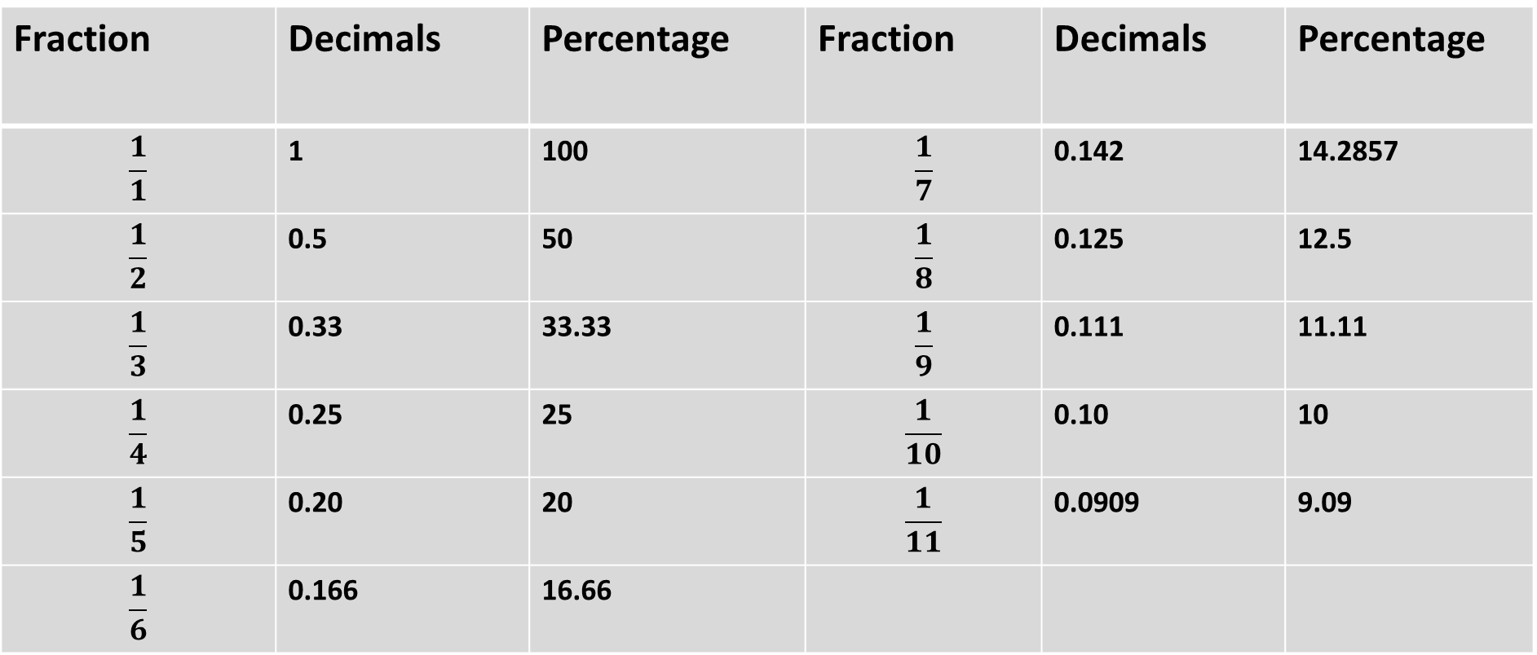
Table of few Fractions to Percentages
Fraction | Decimals | Percentage | Fraction | Decimals | Percentage
$$\frac{1}{1}$$ | 1 | 100 | $$\frac{1}{7}$$ | 0.142 | 14.2857
$$\frac{1}{2}$$ | 0.5 | 50 | $$\frac{1}{8}$$ | 0.125 | 12.5
$$\frac{1}{3}$$ | 0.33 | 33.33 | $$\frac{1}{9}$$ | 0.111 | 11.11
$$\frac{1}{4}$$ | 0.25 | 25 | $$\frac{1}{10}$$ | 0.10 | 10
$$\frac{1}{5}$$ | 0.20 | 20 | $$\frac{1}{11}$$ | 0.0909 | 9.09
$$\frac{1}{6}$$ | 0.166 | 16.66

Slide 7
Explanation of Table

Slide 8
problems
20% of 30 | 27% of 45.45
30% of 20 | 210% of 120
24% of 66.66 | 37% of 53
55.55% of 27 | 77.77% of 180
71.4285% of 35 | 45% of 45

Slide 9
problems
If A earns 20% More then B, then by what percentage does B earns less then A.
2. If A earns 20% less then B, then by what percentage does B earns more then A.

Slide 10
problems
3. If length of Rectangle increases by 20% and its breadth increases by 30%. Find percentage change in the Area?

Slide 11
problems
4. A shopkeeper gives a discount of 10% followed by another discount of 20% on the same commodity. Find a single discount which is equivalent to the given discounts?

Slide 12
1. If y exceeds x by 20%, then x is less than y by?
A. 16% B. 16 1/3 % C. 16 2/3 % D. 16 3/5 %

Slide 13
2.After decreasing 24% in the price of an article costs Rs.912. Find the actual cost of an article?
A. 1400 B. 1300 C. 1200 D. 1100

Slide 14
3. 60% of a number is added to 120, the result is the same number. Find the number?
A. 300 B. 200 C. 400 D. 500

Slide 15
4. If the price has fallen by 10% what percent of its consumption be: increased so that the expenditure may be the same as before?
A. 11% B. 10% C. 11 1/9 % D. 9 1/11 %

Slide 16
5. The salary of Mr. X is 30% more than that of Mr. Y . Find what percent of Mr. Y’s salary is less than Mr. X’s?
A. 30% B. 25 1/13 % C. 23 1/13 % D. 22 1/13 %

Slide 17
6.Two numbers are respectively 20% and 25% more than a third number. The percentage that is first of the second is?
A. 80% B. 85% C. 96% D. 125%

Slide 18
7. A sells his goods 50% cheaper than B but 50% dearer than C. The cheapest is?
A. A B. B C. C D. All Alike

Slide 19
8. The salary of a typist was at first raised by 10% and then the same was reduced by 5%. If he presently draws Rs.1045.What was his original salary?
A. 900 B. 950 C. 1000 D. 975

Slide 20
9. The tax on a commodity is diminished by 20% and its consumption increased by 15%. The effect on revenue is?
A. It increases by 8% B. It decreases by 8% C. No change in revenue D. It increases by 10%

Slide 21
10. If the numerator of a fraction is increased by 20% and its denominator is diminished by 25% value of the fraction is 2/15. Find the original fraction.
A. 1/12 B. 1/8 C. 1/6 D. 1/4

Slide 22
11. An engineering student has to secure 36% marks to pass. He gets 130 marks and fails by 14 marks. The maximum No. of marks obtained by him is?
A. 300 B. 400 C. 350 D. 500

Slide 23
12. A and B’s salaries together amount to Rs. 2,000. A spends 95% of his salary and B spends 85% of his. If now their savings are the same, what is A’s salary?
A. Rs.500 B. Rs.750 C. Rs.1250 D. Rs.1500

Slide 24
13. A salesman’s terms were changed from a flat commission of 5% on all his sales to a fixed salary of Rs.1000 plus 2.5% commission on all sales exceeding Rs. 4,000. If his remuneration as per new scheme was Rs. 600 more than that by the previous schema, his sales were worth?
A. Rs. 14,000 B. Rs. 12,000 C. Rs. 30,000 D. Rs. 40,000

Slide 25
14. 5% people of a village in Sri Lanka died by bombardment, 15% of the remainder left the village on account of fear. If now the population is reduced to 3553, how much was it in the beginning?
A. 3800 B. 4200 C. 4400 D. 5500

Slide 26
15. In a factory, there are 40% technicians and 60% non-technicians. If the 60% of the technicians and 40% of non-technicians are permanent employees, then the percentage of workers who are temporary is?
A. 32% B. 42%
C. 52% D. 62%

Slide 27
16. A mixture of 70 liters of wine and water contains 10% water. How much water must be added to make water 12 ½% of the total mixture?
A. 12 liters B. 10 liters C. 4 liters D. 2 liters

Slide 28
17. The amount of water (in ml) that should be added to reduce 9 ml. Lotion, containing 50% alcohol, to a lotion containing 30% alcohol, is?
A. 3 B. 4 C. 5 D. 6

Slide 29
18. In an office, totally there are 6400 employees and 65% of the total employees are males. 25% of the males in the office are at-least 50 years old. Find the number of males aged below 50 years?
A. 1040 B. 2080 C. 3120 D. 4160

Slide 30
19. In an election between two candidates’ A and B, the number of valid votes received by A exceeds those received by B by 15% of the total number of votes polled. If 20% of the votes polled were invalid and a total of 8720 votes were polled, then how many valid votes did B get?
A. 2160 B. 2420 C. 2834 D. 3150

Slide 31
20. The ratio of the prices of three articles X, Y and Z is 8 : 5 : 3. If the prices of X , Y and Z are increased by 25%, 20% and 33 1/3% respectively, then what would be the ratio of the new prices of X, Y and Z?
A. 5 : 3 : 1 B. 5 : 3 : 2 C. 10 : 7 : 4 D. 10 : 8 : 5

Slide 32
Notes:
http://www.leadthecompetition.in/reasoning/questions-on-relations.html
https://www.sawaal.com/blood-relations-questions-and-answers/a-is-bs-sister-c-is-bs-mother-d-is-cs-father-e-is-ds-mother-then-how-is-a-related-to-d_4150
https://www.toppr.com/guides/reasoning-ability/blood-relations/blood-relations-practice-questions/

